Slide 1

Project Blink
Proof of Speed - 1.7 Snips & Bi-Gossip Model

Slide 2
Need for Faster Propagation
Blockchain needs a faster propagation for validators to attest downloaded blocks
For a very high-throughput blockchain a random propagation and download-propagate won’t work. Making special relay networks shall centralize the chain. Propagation should be over internet protocols such as TPS but at the same time should be high-frequency efficient
Since Blinkchain achieves speed using time-based competition, the propagation of blocks matter the most

Slide 3
Objectives
Data propagation has to be size-effective
Should have a predictable distribution result
Effective against forks and chain-choosing methods
Should encourage highly efficient parallel validation
Better accountability for timed-out blocks and unconfirmed transactions
Should cooperate with Proof-of-Speed competition

Slide 4
Solution - Faster Propagation
Bi-Gossip Model
Beeline Gossip: A producer/leader to producer/leader point-to-point gossip system.
Distributed Gossip: A leader/producer to full nodes distributed gossip system.
Memory Pools
Mem-pool - Leader only local pool for unconfirmed transactions.
Snip-pool - Local pool for graphing gossiped snips

Slide 5
Snips
Snips are small data chunks of a blink "block" minted by a block producer for their assigned packet
Snips get the idea from streaming data to receive nuggets of furnished data which can be evaluated than downloading a whole single data file
Since data propagation in blinkchain gets expensive to distribute in whole/large data blocks, the blocks are isolated into independent data files upon creation, which are denoted as a "Snip" of a blink
Each Snip will contain the hash-seqence count and its external transactions

Slide 6
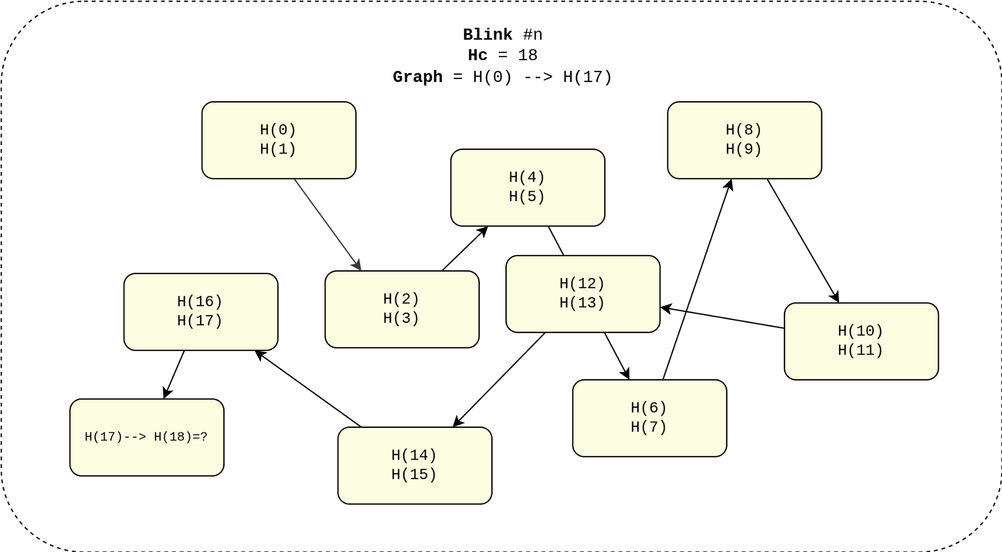

Slide 7
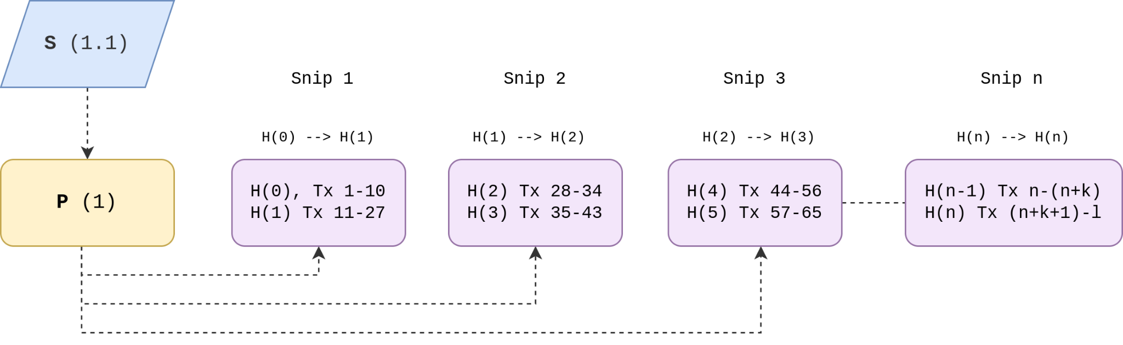
Snips - Creation
Snips are created and immediately propagated via the Bi-Gossip Model
A blink shall be only formed by the receiving validator, not the miner. The miner only creates snips

Slide 8
Snips - Linking
Snips are dropped in snip-pools which are linked with each other similar to blockchains
Validators are required to join snips and attest as blockchains
Timeouts are identified here, as when a delay is detected by a validator he can attest the block resulting in fee slashing to the miner
Minimum is a single hash-count in a snip
Snips are only a way of streaming blocks in separate chunks and later formed in complete blink

Slide 9
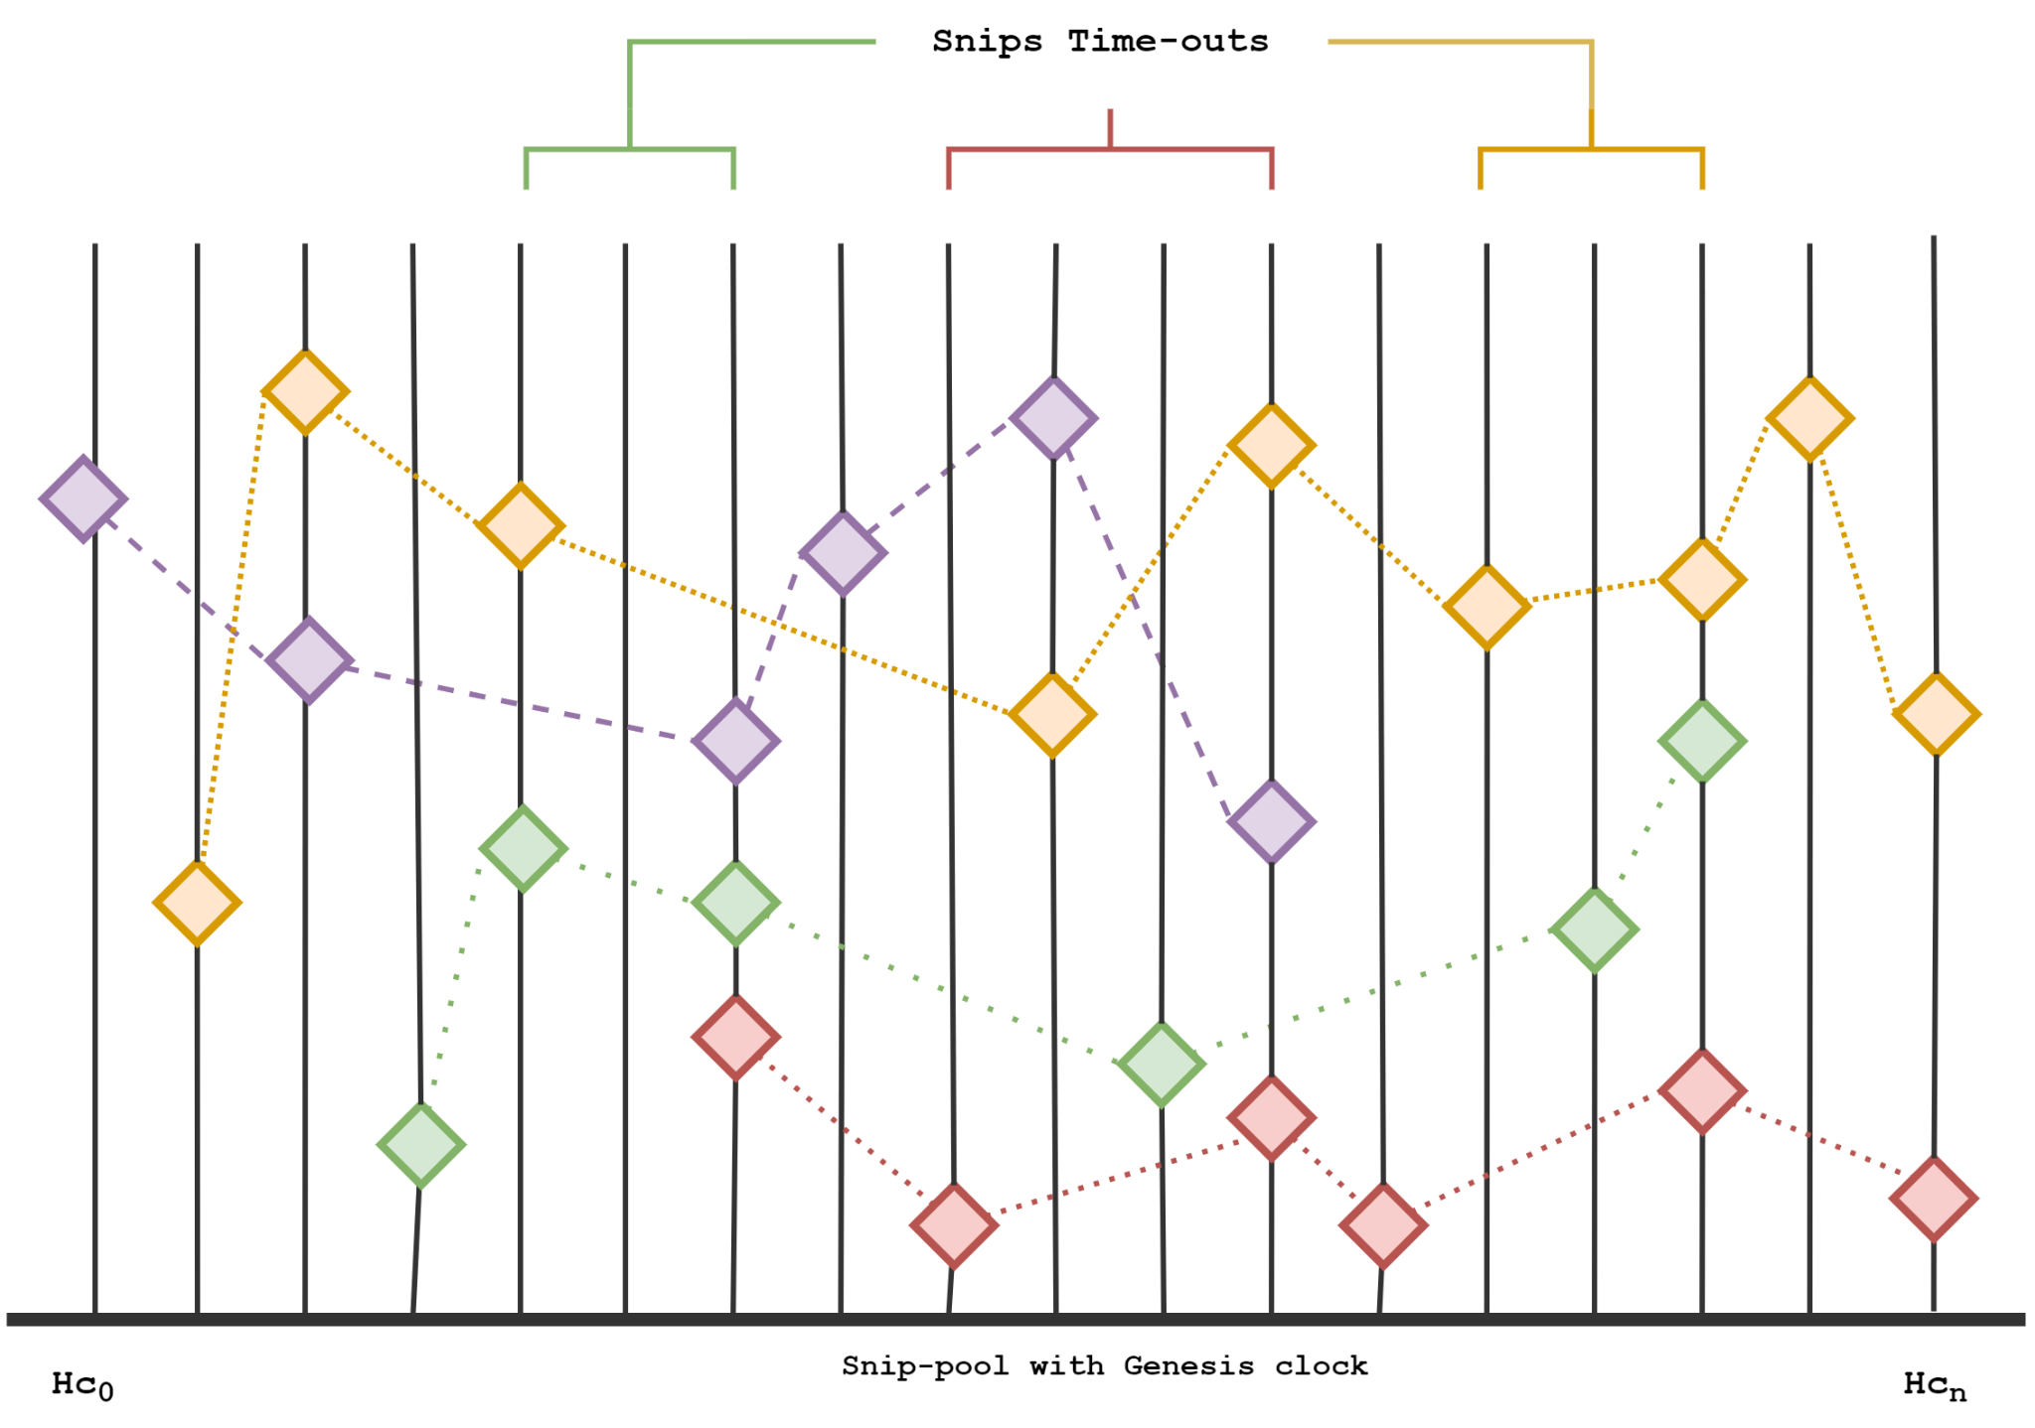

Slide 10
Bee-line Gossip
Beeline gossip is a straight-line point-to-point propagation of snips in real-time where the producers, slot leaders, and epoch leaders pre-configure their peers on a priority list to send and receive blocks by evaluating the Proof-of-Choice election results.
The pre-configuration of the priority list makes a list of peers and their information to fetch or return data which updates every block/packet/slot once the snips are formed and the blink ”block” is minted.

Slide 11
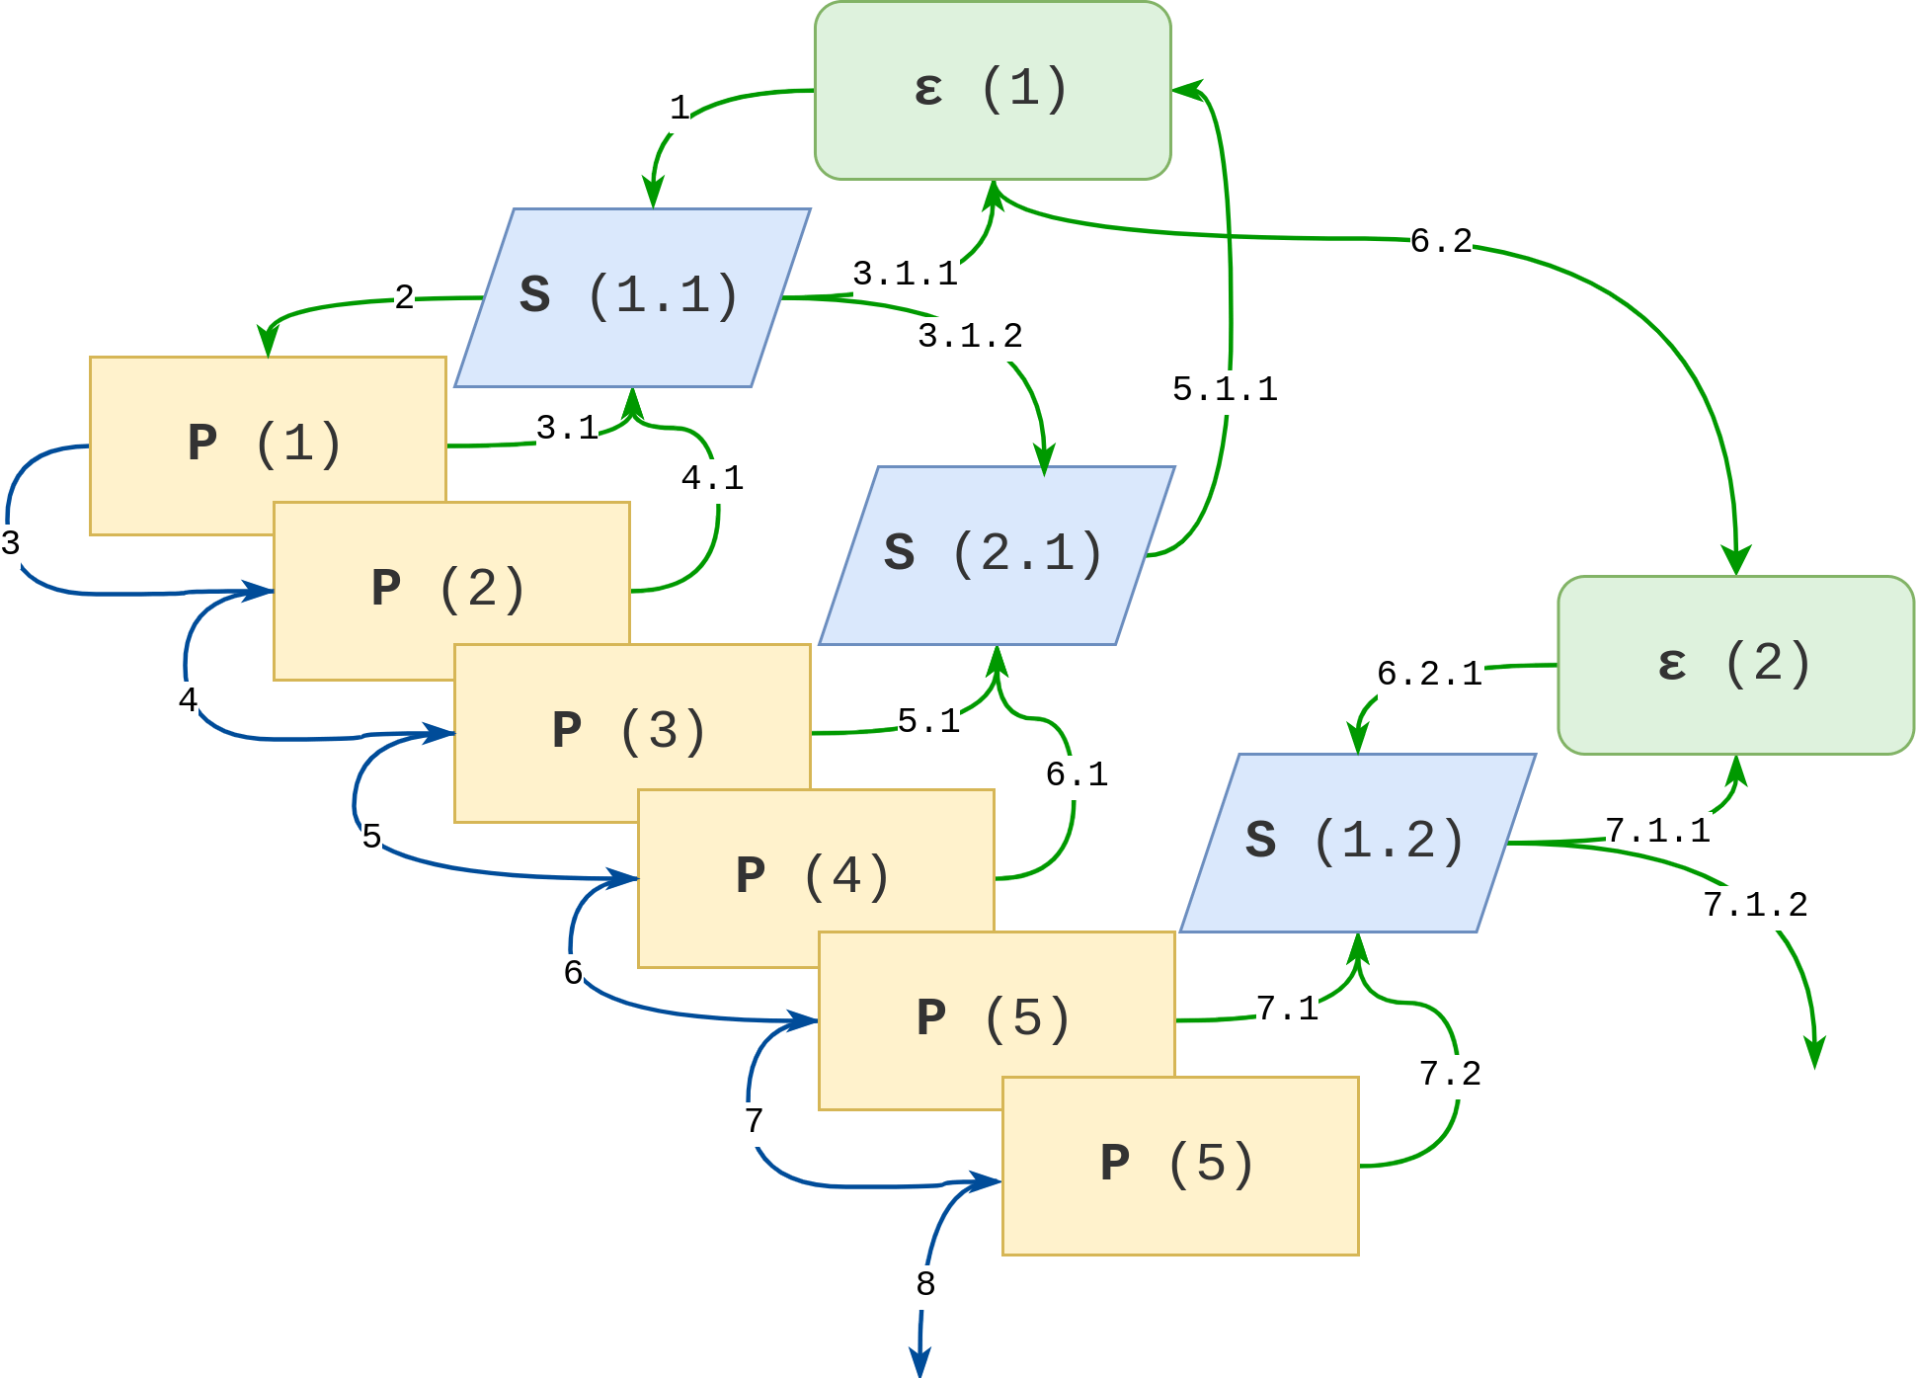

Slide 12
Transmission Types
Producer to Producer: For propagating newly minted snips. Only works in forward - Packet Owner (n) → Packet Owner (n+1),(n+2),(n+3) not backwards.
Producer to Leader: Newly minted snips are sent to the exact slot leader for them to update their mempool.

Slide 13
Transmission Types
Leader to Producer:
Un-confirmed transactions to nth packet owner for them to mint as snips
Minted snips to expired packet owners, to add them to snip-pool and validate the blink
Leader to Leader: For updating the mem pools, leaders from slots and epochs send newly minted snips between each other both forward and backward.

Slide 14
Distributed Gossip
Distributed gossips are exactly similar to current data flooding dissemination protocols which multicasts the data to a group of nodes simultaneously.
This type of gossip is used for full node propagation as the snips data can be delivered at ease, aggregated, and validated in a blink.
Full nodes and non-competent nodes are required to store data for decentralization purposes and client-side communication purposes. Hence, usual dissemination protocols used in popular blockchains are used. Delays are avoided during rumoring, to restrict unwanted timeouts between snips of blinks.

Slide 15
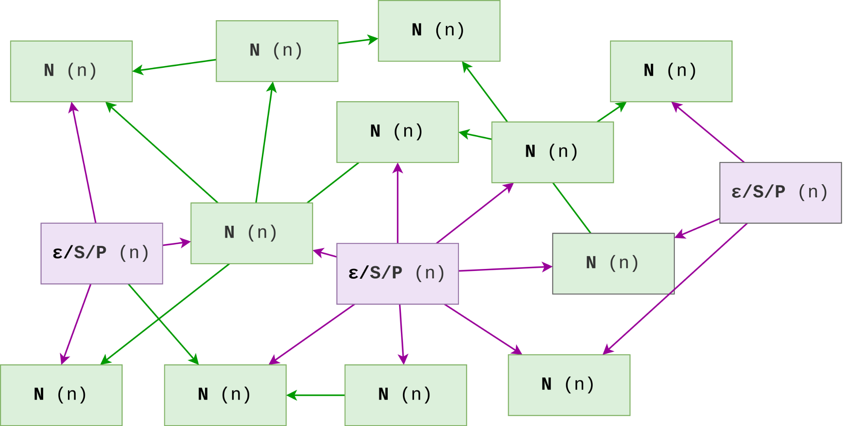

Slide 16
Next : 2.0 Proof of Choice Intro

